Slide 1


CMR TECHNICAL CAMPUS UGC (Autonomous) Kandlakoya, Medchal Road, Hyd-501401 Department of Computer Science and Engineering
ESTD: 2009
A
Major Project On
PROBABILISTIC INFERENCE AND TRUSTWORTHINESS EVALUATION OF ASSOCIATIVE LINKS TOWARDS MALLICIOUS ATTACK DETECTION FOR ONLINE RECOMMENDATIONS
BATCH NO: 19
GROUP MEMBERS :
207R1A05B4 S. Divya
207R5A0567 B. Lahari
207R1A0592 M. Sri Harsha
UNDER THE GUIDANCE OF:
MS TABEEN FATIMA
(Assistant Professor)

Slide 2
CONTENTS
Abstract
Existing System
Disadvantages in Existing System
Proposed System
Advantages of Proposed System
Hardware and Software Requirements
Novelty
Modules
Architecture
UML Diagrams
Sample Code
Results
Conclusion
Future Scope
References

Slide 3
ABSTRACT
The increasing use of recommender systems as personalization recommendation services such as Amazon, TripAdvisor, and Yelp, has stressed the demand for secure and usable abnormality detection techniques, due to fundamental vulnerabilities of recommender systems and their openness.
With the emergence of new attacks, how to defend diverse malicious attacks for online recommendations is a challenging issue.
Moreover, characterizing and evaluating sparse rating behaviours are a long-standing problem that still remains open, leading to an upsurge of research, as well as real application.

Slide 4
EXISTING SYSTEM
With the development of machine learning and online social network, researchers have begun to investigate detection models from the perspectives of supervised, unsupervised and semi-supervised learning.
On the other hand, graph-based detection methods for spotting fake accounts or Sybil nodes have been well developed.
Investigating attributes of link behavior in association graphs has also attracted much attention.

Slide 5
DISADVANTAGES IN EXISTING SYSTEM
False Positives/Negatives
Scalability
Complexity
Adversarial Attacks
Privacy Concerns

Slide 6
PROPOSED SYSTEM
We develop a unified representation of injection behaviors to deal with different injection attacks, and propose to combine the iteration propagation of behaviors and atomic propagation rules of coupled networks for both the trustworthiness evaluation of nodes and the determination of disturbed information.
We propose a unified detection approach to identify both profile injection attacks and co-visitation injection attacks.
Additionally, discovering spam users on Trip Advisor and Amazon data is also investigated and analyzed.

Slide 7
ADVANTAGES OF PROPOSED SYSTEM
Improved Accuracy
Enhanced Scalability
Efficient Resource Utilization
User Privacy Protection

Slide 8
Hardware and Software Requirements
Hardware Requirements:
Processor : Pentium –IV
RAM : 4 GB (min)
Hard Disk : 20 GB
Key Board : Standard Windows Keyboard
Mouse : Two or Three Button Mouse
Monitor : SVGA
Software Requirements:
Operating system : Windows 7 Ultimate.
Coding Language : Python.
Front-End : Python.
Back-End : Django-ORM
Designing : Html, css, javascript.
Data Base : MySQL (WAMP Server)

Slide 9
NOVELTY
The project of probabilistic inference, trustworthiness evaluation of associative links, and malicious attack detection for online recommendations are all areas of ongoing research and development.
The novelty lies in the application of probabilistic reasoning to evaluate the trustworthiness of links in online recommendation systems.
By integrating the probabilistic models into recommendation systems, it is possible to improve the system's ability to detect and filter out malicious content or attacks aimed at manipulating recommendations.

Slide 10
MODULES
Service Provider : The Service Provider has to login by using valid user name and password. After login successful he can do some operations.
Remote User : There are n numbers of users are present. User should register before doing any operations.

Slide 11
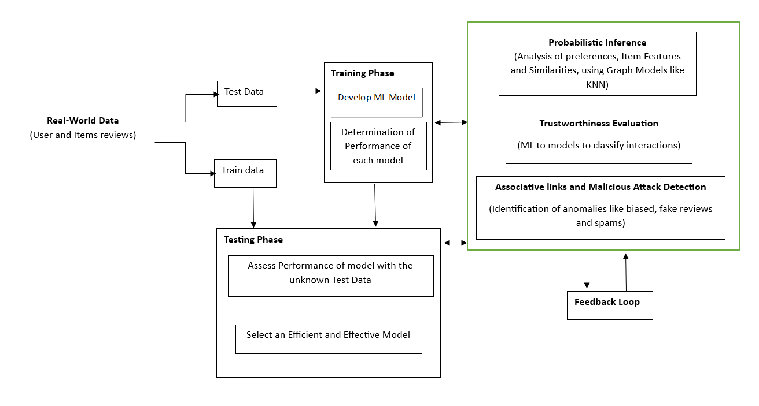
ARCHITECTURE

Slide 12
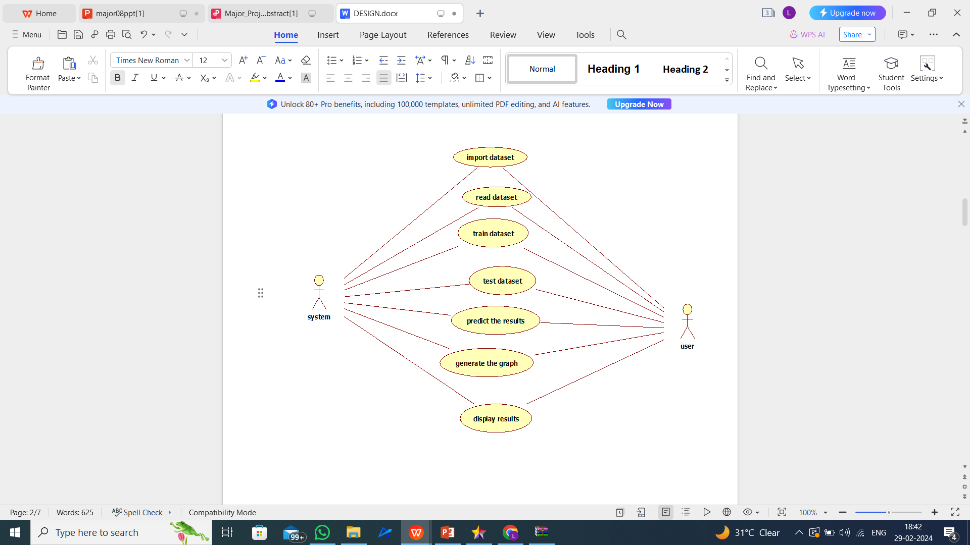
UML DIAGRAMS
Use case Diagram

Slide 13
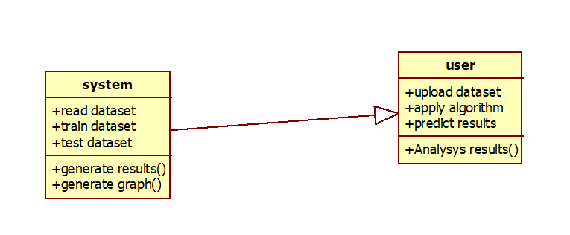
Class Diagram

Slide 14
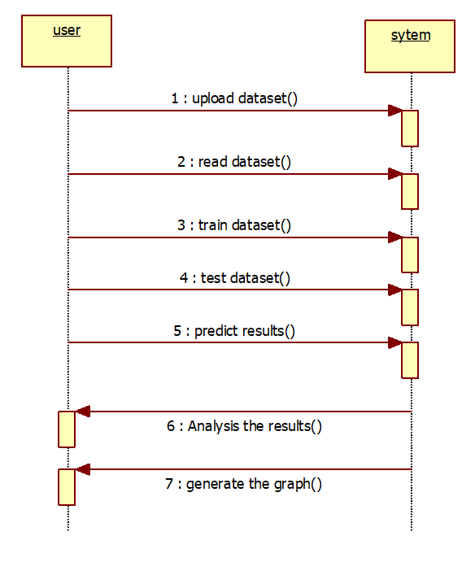
Sequence Diagram

Slide 15
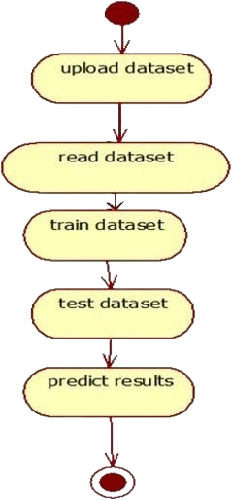
Activity Diagram

Slide 16
SAMPLE CODE
# SVM Model
print("SVM")
from sklearn import svm
lin_clf = svm.LinearSVC()
lin_clf.fit(X_train, y_train)
predict_svm = lin_clf.predict(X_test)
svm_acc = accuracy_score(y_test, predict_svm) * 100
print(svm_acc)
print("CLASSIFICATION REPORT")
print(classification_report(y_test, predict_svm))
print("CONFUSION MATRIX")
print(confusion_matrix(y_test, predict_svm))
models.append(('svm', lin_clf))
detection_accuracy.objects.create(names="SVM", ratio=svm_acc)

Slide 17
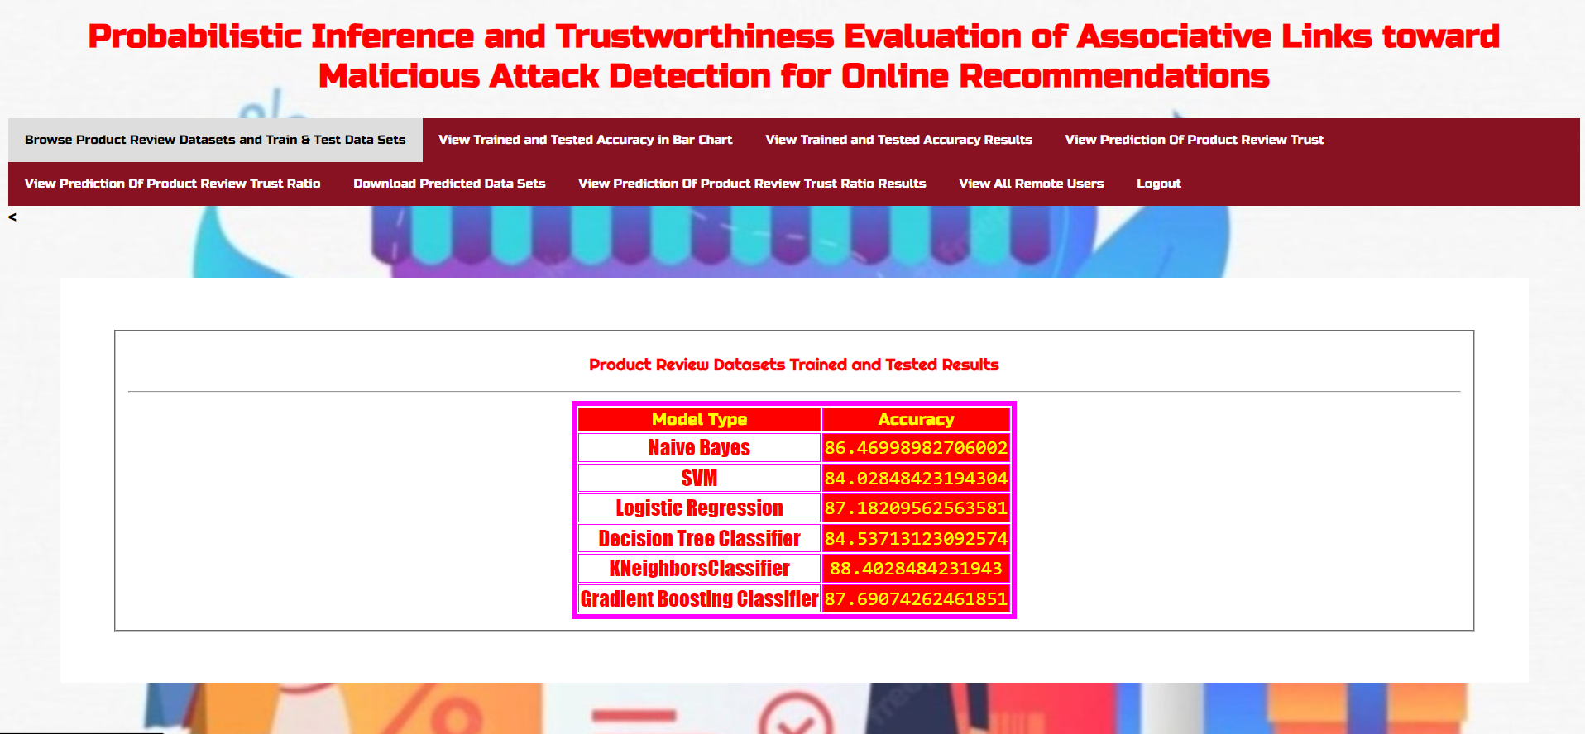
RESULTS

Slide 18
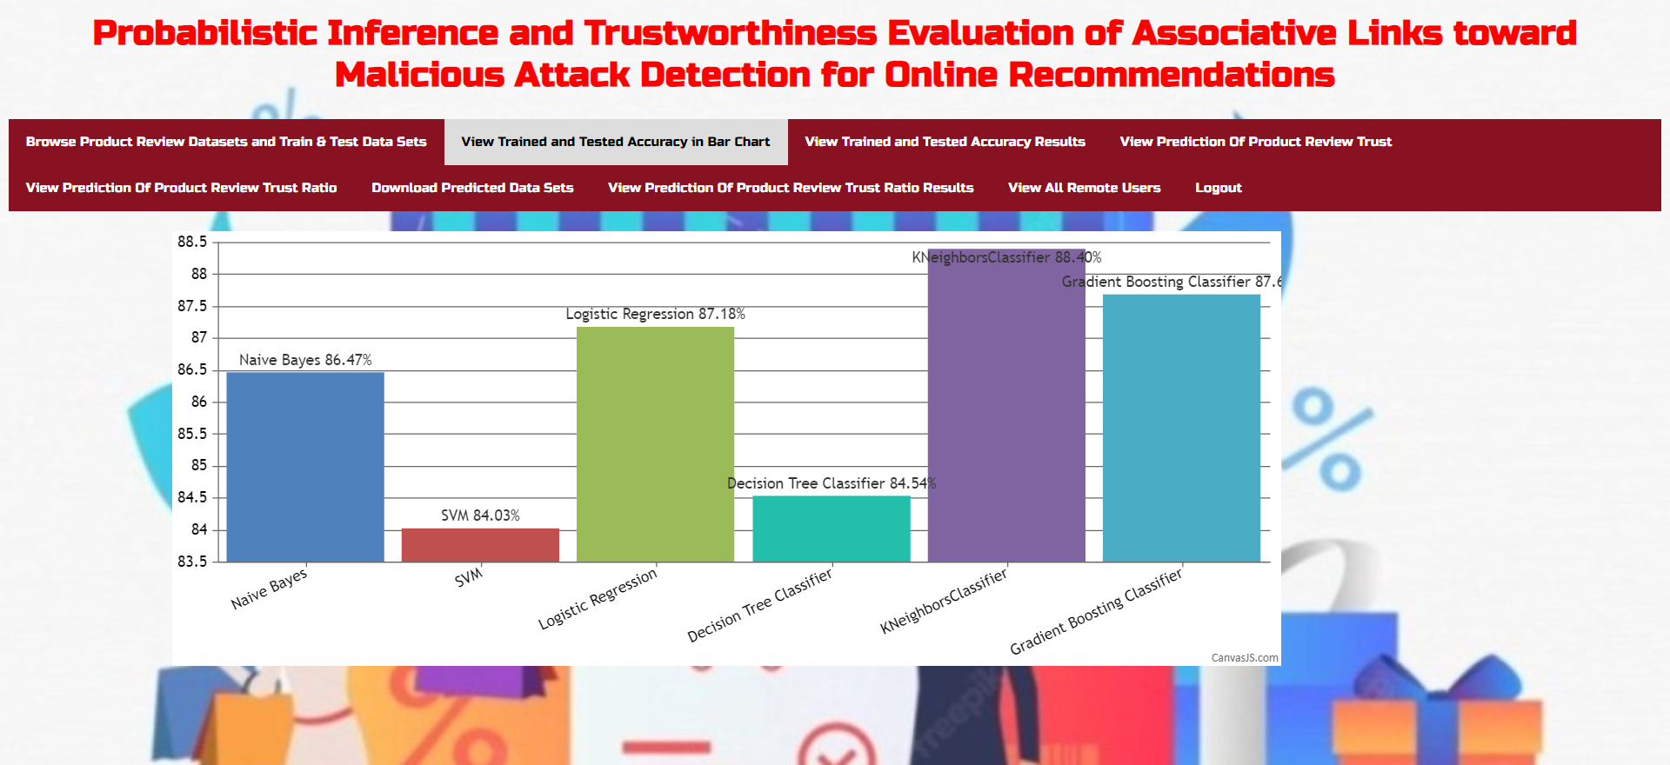

Slide 19
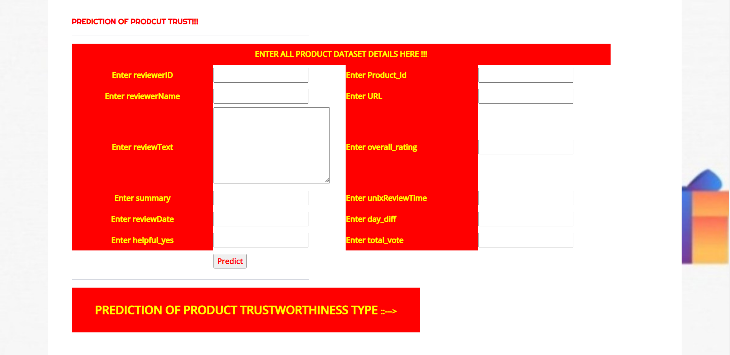
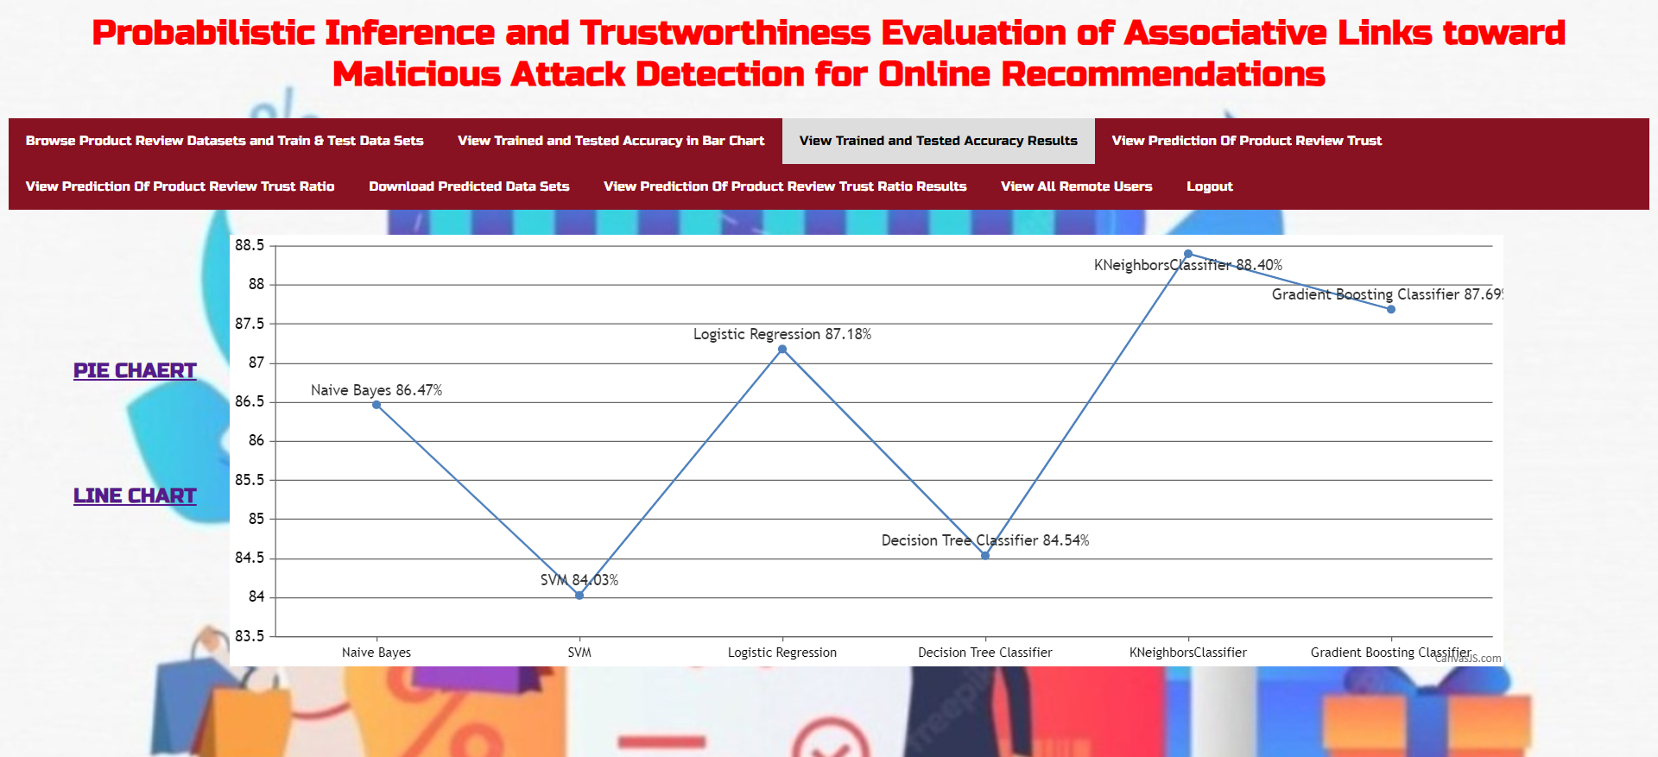

Slide 20
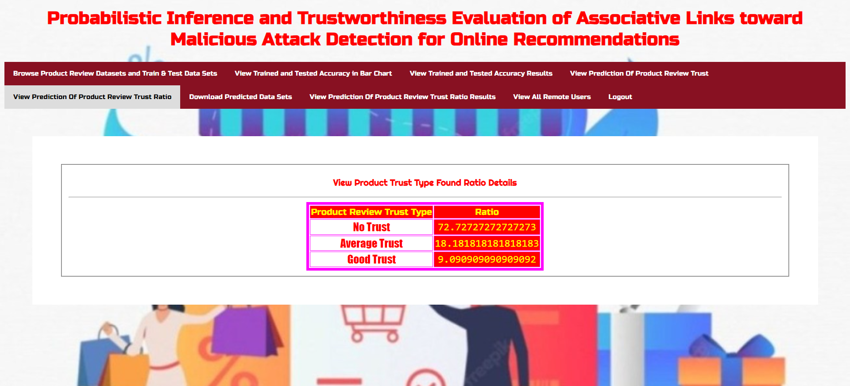

Slide 21
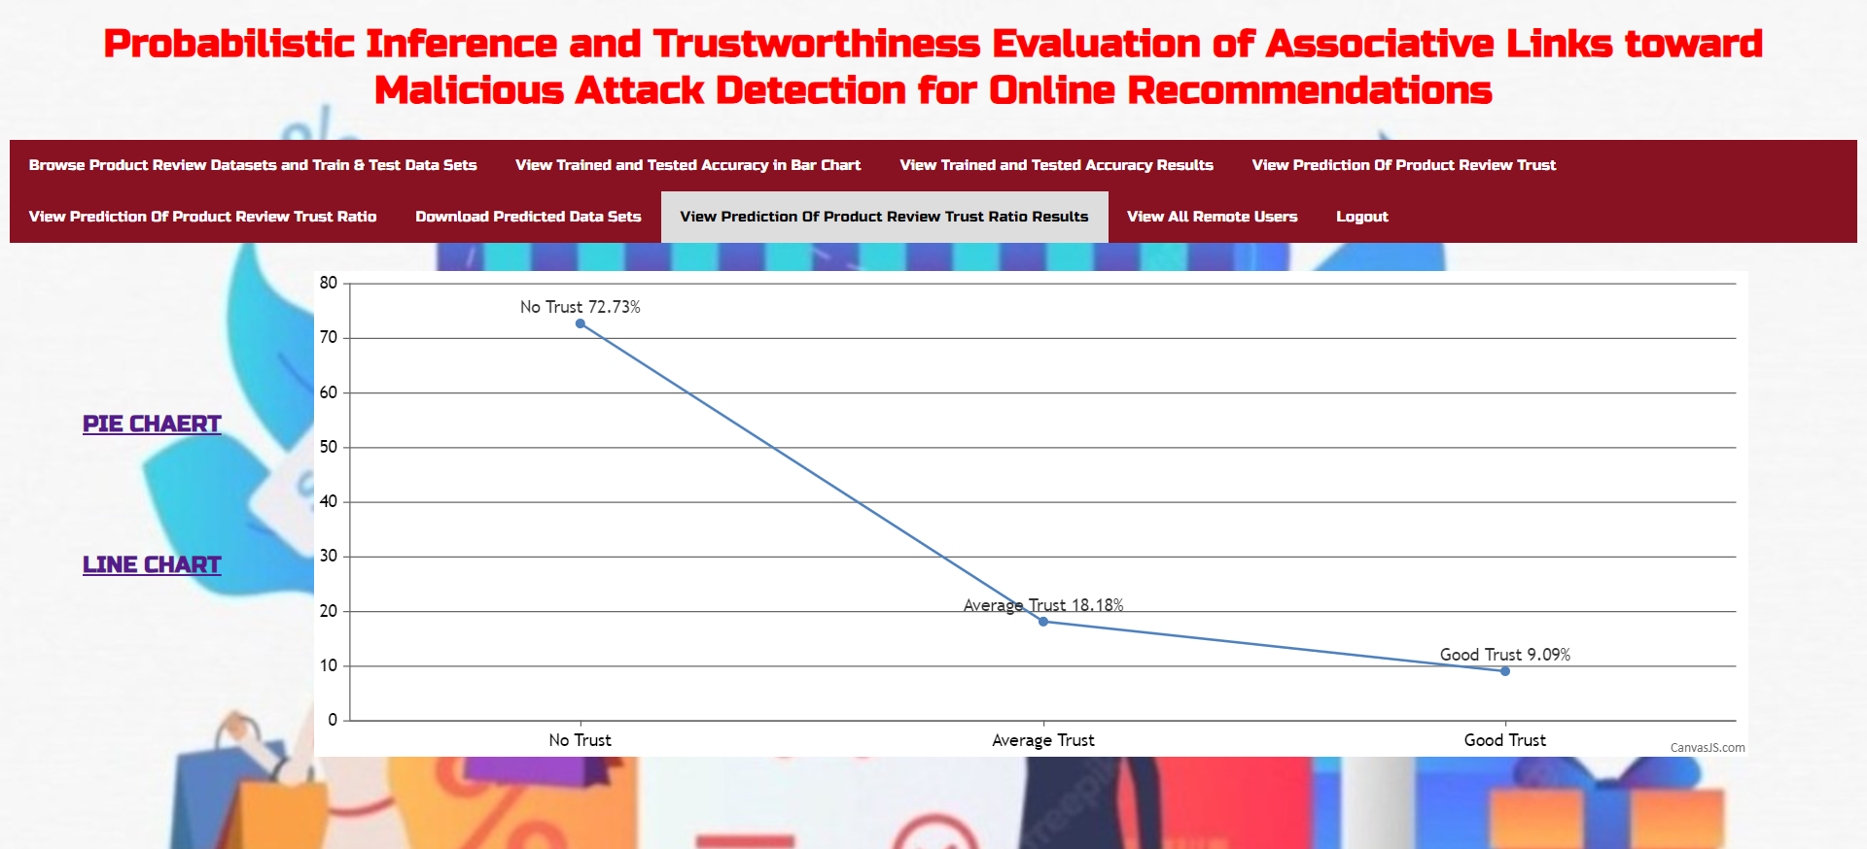

Slide 22
CONCLUSION
In conclusion, this project aimed to address the critical issue of malicious URL detection through the implementation of novel features and the utilization of the Support Vector Machine (SVM) algorithm.
By extracting both static and dynamic features from URLs, we developed a robust classification system capable of accurately distinguishing between benign and malicious URLs.
The results demonstrate the efficacy of the proposed system in effectively identifying malicious URLs with a high degree of accuracy.

Slide 23
FUTURE SCOPE
The future scope for probabilistic inference and trustworthiness evaluation of associative links for malicious attack detection in online recommendations is promising, with several potential areas of advancement:
Integration of Advanced Machine Learning Techniques
Privacy-Preserving Mechanisms
Cross-Domain Application

Slide 24
REFERENCES
M. Fang, G. Yang, N. Gong, and J. Liu, “Poisoning attacks to graph-based recommender systems,” ACSAC, arXiv preprint arX_x0002_iv:1809.04127, 2018.
P. Chirita, W. Nejdl, and C. Zamfir, “Preventing shilling attacks in online recommender systems,” In Proceedings of the 7th annual ACM WIDM, pp. 67–74, 2005.
C. A. Williams, B. Mobasher, R. Burke, and R. Bhaumik, “Detecting profile injection attacks in collaborative filtering: a classification_x0002_based approach,” Advances in Web Mining and Web Usage Analysis, pp. 167–186, 2007.
J. Calandrino, A. Kilzer, A. Narayanan, E. Felten, and V. Shmatikov, “You might also like: Privacy risks of collaborative filtering,” IEEE Symposium on Security and Privacy (SP), pp. 231–246, 2011.
GitHub Link: https://github.com/bollepallylahari/Probabilistic-Inference

Slide 25
Thank You

